Slide 1

Swap4U
T1A3 - Terminal Application
Anon Jaloenklung

Slide 2

About App
Swap4U is a small application that creates questionnaires where the admin can create questions as needed. It is suitable for use in creating a variety of questionnaires because the application itself can generate questions and answers independently. The application has the ability to create questionnaires in the form of Open Ended Question and Close Ended Question or other forms of questionnaires depending on the application of this user.

Slide 3
Why development?
In the past, questionnaires were available in paper form distributed at various locations to ask the opinions of the target groups. The people who distribute the questionnaire will be distributed in the place that is the gathering place of that target audience. Nowadays, creating the same questionnaire is a huge waste and time-consuming process. Because due to many factors example, the current behaviour has changed and people are paying attention to communication devices or social media. Therefore, Swap4U has a direct solution to this problem because it is a small application and is also easy to use. Because no matter how many eras have passed, information from that target audience is essential to many companies and businesses. Because the information is very valuable in today's times, for example doing business or advertising, if the lack of target audience data, there is a very useless opportunity to invest.

Slide 4

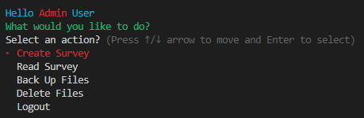
Features
User System
User system is divided into two parts to operate between the admin and general user.
Quiz & Answer Storage
The information entered through the application, whether it be creating a query or user-generated data, is stored in the CSV database.
Selection Menu [UI]
Providing user convenience with a menu system built with TTY:: Prompt Gem.

Slide 5

Challenges
Bringing knowledge of multiple coding tools into one application.
A lot of mistakes you have to encounter when using a variety of tools, often causing errors to make the app unusable.
Learning something new, such as a combination of complementary tools like gems.

Slide 6
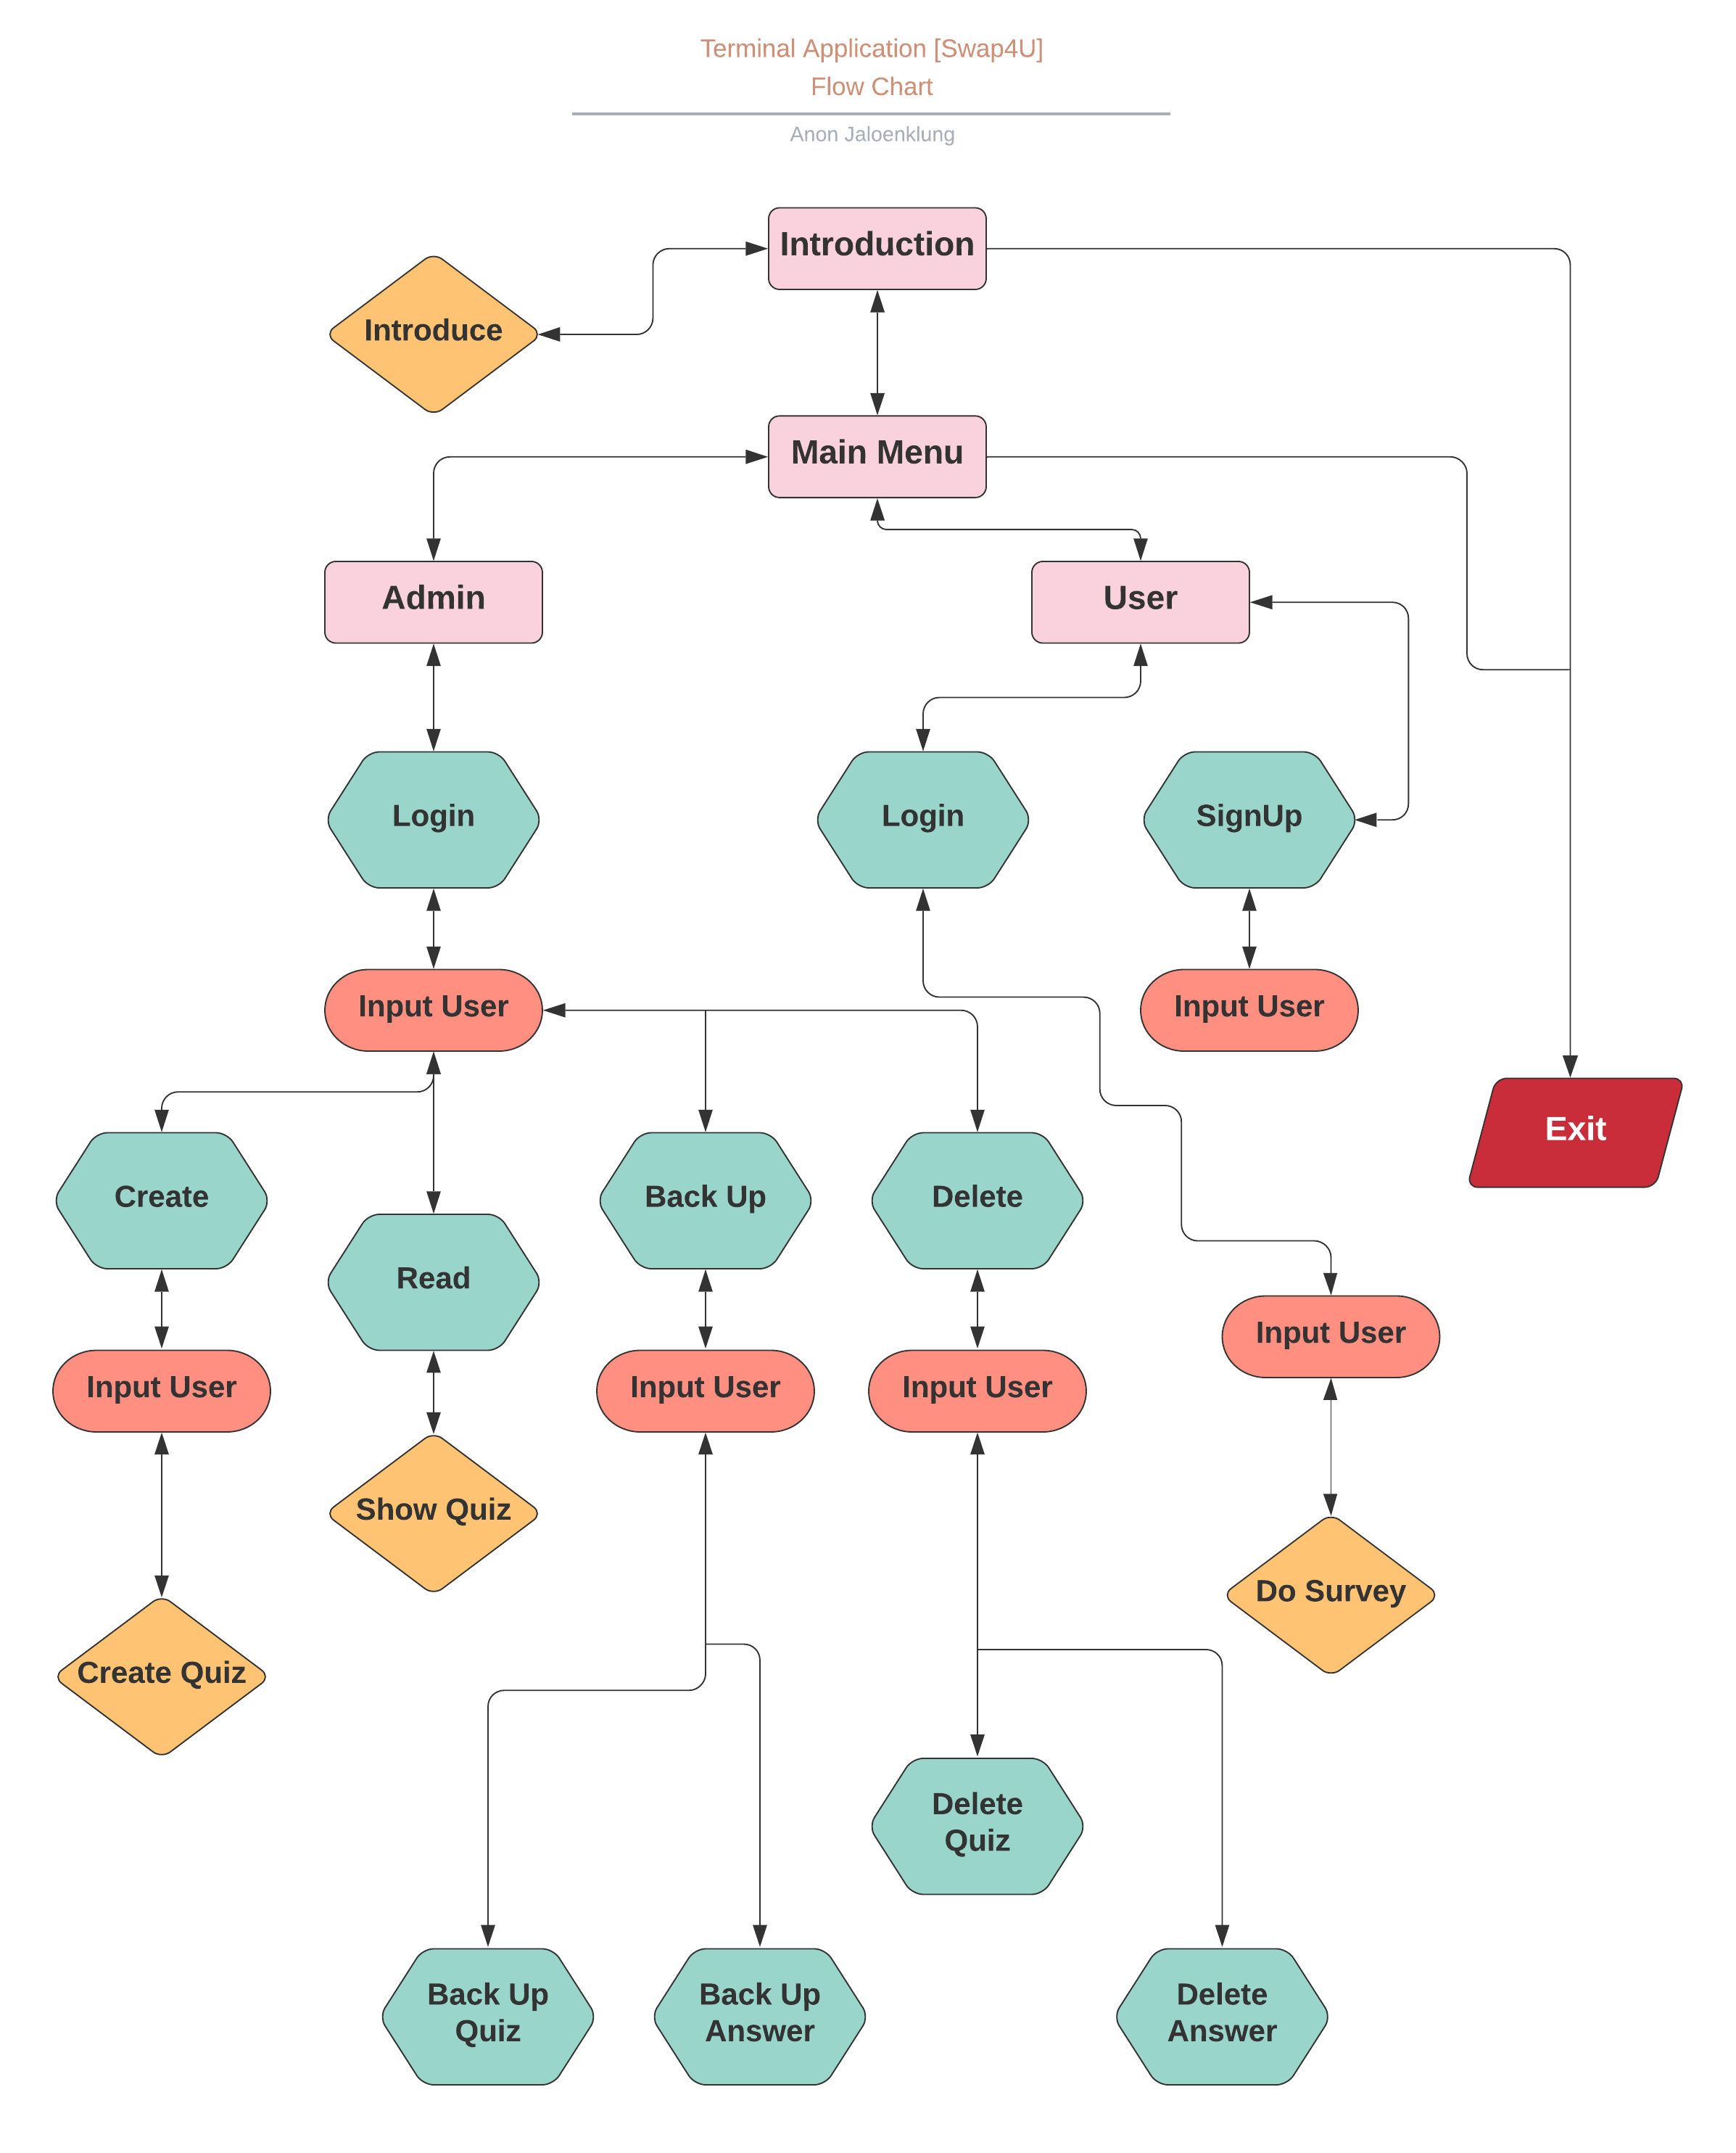
Flow Chart

Slide 7
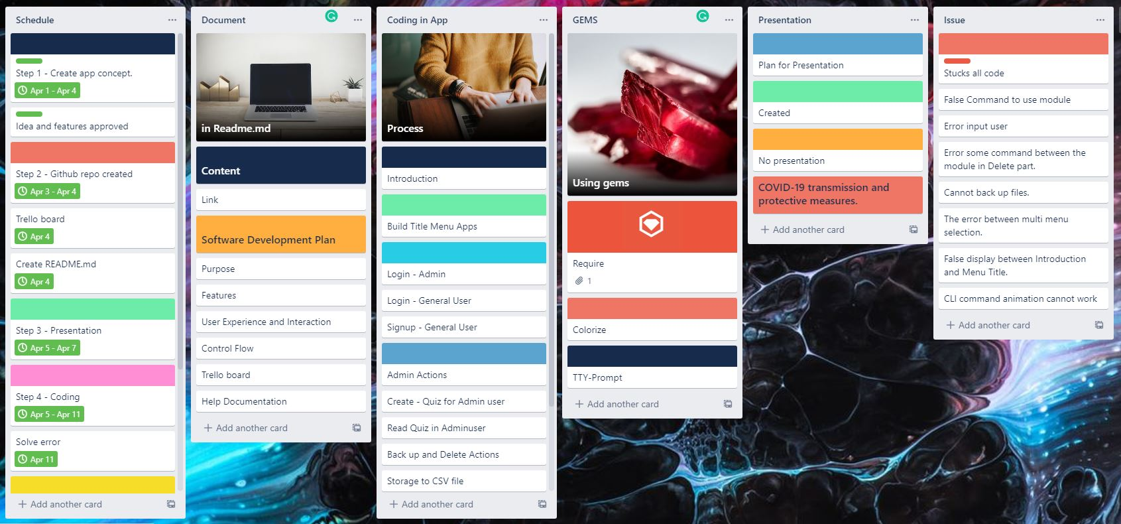
Trello Board

Slide 8

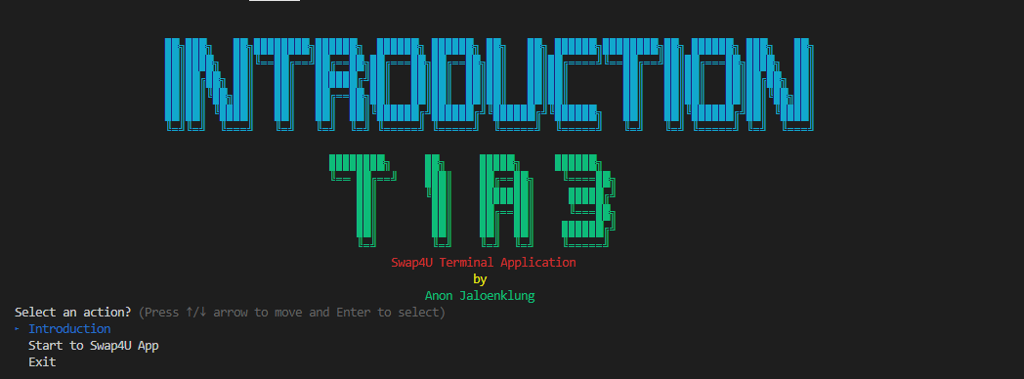
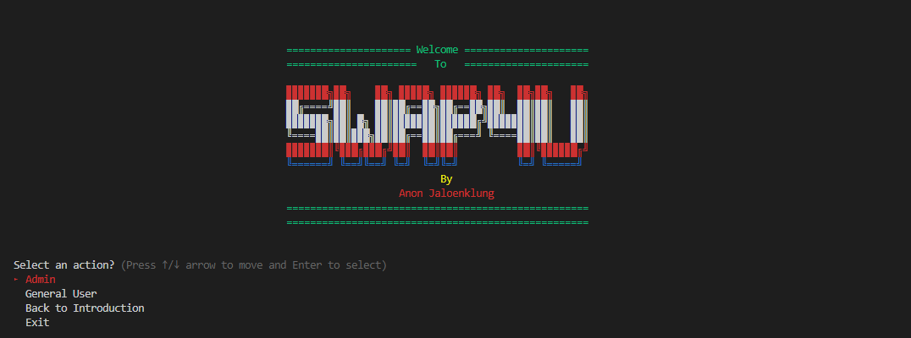
Overview
Terminal application
The app is divided into two phases:
In the introduction, tell us how to use the app before entering Swap4U app.
The second is Swap4U, which is an app that allows users to create questionnaires or take surveys.

Slide 9
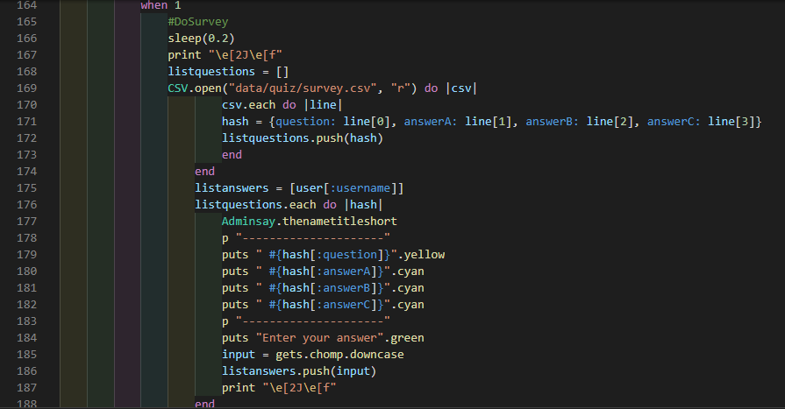
Overview
Code
This is the main factor of this app: it retrieves the information of the question that the admin creates to show the user and the input to send it back to the CSV database.

Slide 10
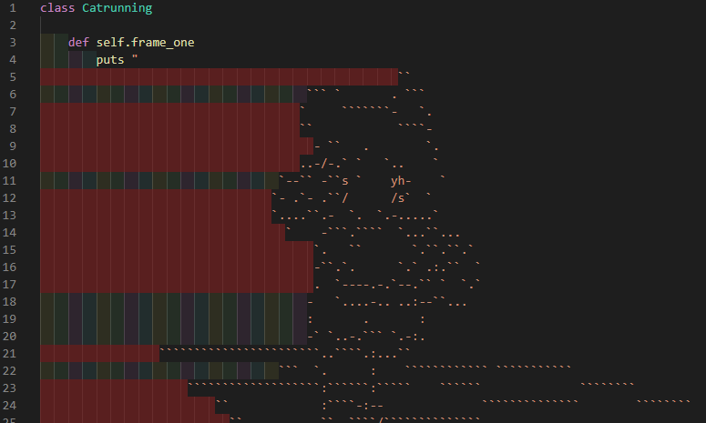
Overview
Code
This section is a simple combination of several commands, working similarly to composing a .GIF image. This creates a code movement similar to animation.

Slide 11
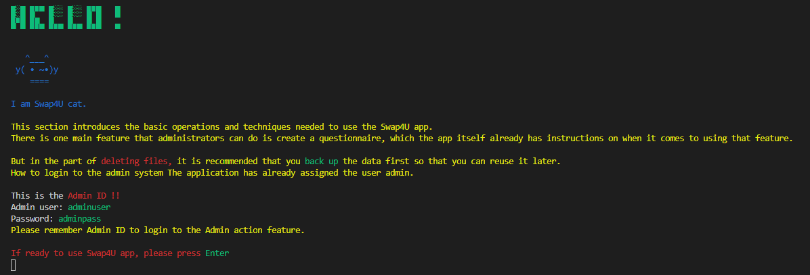
Favourite parts
My favourite part is the introduction page, which runs some animation-like code before it appears in this window.

Slide 12

Expected goal
Initially set goals could not be achieved, such as an automatic email sending feature when the admin created a new question. This is due to the ability to not come enough and not learn it in time, which is expected next time will do this feature.

Slide 13
Thank you

